Slide 1
Policy on the Use of Artificial Intelligence in Education
prepared by: Michel Dumontier
version: 1.0.0
created: February 6, 2024
last modified: February 19, 2024
published on: February 19, 2024
http://tinyurl.com/ai4education

Slide 2
Policy on the Use of Artificial Intelligence in Education
© 2024 by Michel Dumontier is licensed under Attribution 4.0 International
To view a copy of this license, visit http://creativecommons.org/licenses/by/4.0/
This license requires that reusers give credit to the creator. It allows reusers to distribute, remix, adapt, and build upon the material in any medium or format, even for commercial purposes.

Slide 3
Use of AI (LLMs) is permitted unless specifically prohibited.
Large Language Models (LLMs) represent a groundbreaking advancement in natural language processing and natural language understanding. They are have enormous potential to improve productivity, but you must use them in an ethical manner in this course.
You are here to develop your skills and knowledge. Relying too heavily on LLMs can hinder critical thinking and problem-solving skills. It's important that you use them as a tool (a co-pilot) rather than a replacement for your own analysis and creativity.
Basically, use LLMs to learn about a subject, obtain feedback on ideas/work, prototyping and code generation, and improving the quality of english in reports. If used, cite the LLM/system used, and reflect on their use (e.g. accuracy, bias, relevance) in your assignments / project.
Inappropriate use will be referred to the board of examiners; consequences range from getting a zero on a course component, to failing the course, to expulsion from the university.

Slide 4
Capabilities of Large Language Models
Vast Knowledge Base: LLMs are trained on extensive datasets, encompassing a wide range of topics. This enables them to provide information and generate content on a multitude of subjects.
Language Understanding and Generation: They are adept at understanding and generating human-like text, making them useful for tasks like summarizing information, answering questions, and creating content.
Multilingual Support: Many LLMs can understand and respond in multiple languages, making them valuable for language studies and translation tasks.
Pattern Recognition: They are excellent at identifying patterns in data, which can be beneficial in analyzing trends, making predictions, or finding correlations in research.
Assistance in Creative Processes: LLMs can assist in creative writing, idea generation, and brainstorming, providing new perspectives or suggestions that can spark creativity.
Programming Help: They can assist in coding by suggesting code snippets, debugging, or explaining programming concepts.

Slide 5
Limitations of Large Language Models
Lack of Understanding: LLMs do not understand content in the way humans do. They generate responses based on patterns in data rather than true comprehension.
Inaccuracies and Factual Errors: LLMs can generate plausible-sounding but inaccurate or false information. They don't have the ability to fact-check or verify the accuracy of their outputs.
Contextual Misunderstandings: They sometimes struggle with understanding and maintaining context, especially in complex or nuanced discussions.
Dynamic Knowledge Limitation: LLMs are not updated in real-time. Their knowledge is limited to the data available up to the point of their last training, making them less useful for current events or very recent developments.
Bias in Data: LLMs can perpetuate biases present in their training data. This can lead to skewed, unfair, or offensive outputs and requires careful examination of their responses.
Limited Creativity: Their outputs, while sometimes novel, are fundamentally derivations of existing data. True creativity or out-of-the-box thinking is beyond their capability.
No Moral or Ethical Judgment: LLMs lack the ability to make moral or ethical judgments. They may inadvertently generate harmful, biased, or inappropriate content if not properly guided.

Slide 6
Inappropriate use of large language models
Plagiarism and Misrepresentation
Submitting AI-Generated Work as Original: Using a language model to complete an assignment and submitting it as entirely one's own work without disclosure.
Lack of Attribution: Not crediting the use of a language model when it has significantly contributed to the creation of the content.
Bypassing Learning Objectives
Avoiding Skill Development: Relying on language models to perform tasks that are meant to develop specific skills, such as critical thinking, research, writing, or problem-solving.
Circumventing Course Requirements: Using a language model to complete tasks that are designed to assess the student's understanding or mastery of the subject matter.
Unethical or Harmful Content Generation
Creating Inappropriate Content: Using language models to generate offensive, discriminatory, or harmful content.
Spreading Misinformation: Utilizing language models to produce or disseminate false or misleading information.

Slide 7
Inappropriate use of large language models
4. Privacy Violations and Sensitive Data
Inputting Sensitive Information: Entering personal or sensitive data into a (remote) language model, which could potentially breach privacy or data protection policies.
Compromising Confidentiality: Using language models in a way that could disclose confidential or proprietary information.
5. Disregarding Intellectual Property
Infringing Copyright: Using a language model to replicate or slightly modify existing copyrighted works without proper attribution or violating fair use principles.
6. Manipulation and Dishonesty
Misleading Peer Review or Feedback: Employing a language model to give the impression of peer engagement or fabricating peer reviews.
Deceptive Communications: Using a language model to write emails or messages to instructors or peers under false pretenses.

Slide 8
Inappropriate use of large language models
7. Over-reliance and Lack of Engagement
Over-dependence: Relying excessively on language models for completing assignments, leading to a lack of engagement with the learning material and educational process.
8. Violating Institutional Policies
Contravening Specific Guidelines: Using language models in ways that are explicitly prohibited by Maastricht University policies for technology use.

Slide 9
Disclosure
This guide was prepared using OpenAI's ChatGPT 4.0 (accessed on by subscription). Specifically, the LLM was used to generate a response to the following questions:
Help me prepare an student ethics guide for the use of large language models in a masters level course.
Elaborate on the purpose of the guide.
Elaborate on the capabilities and limitations of large language models
Elaborate on what would constitute inappropriate use of large language models for course assignments.
What are possible consequences of misuse ?
The answers to these questions were transcribed verbatim with minimal editorial changes (rephrasing, reordering of points, removal of less relevant points).

Slide 10
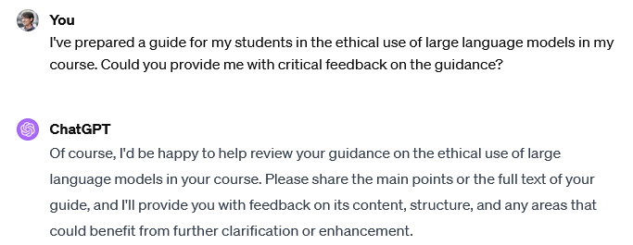
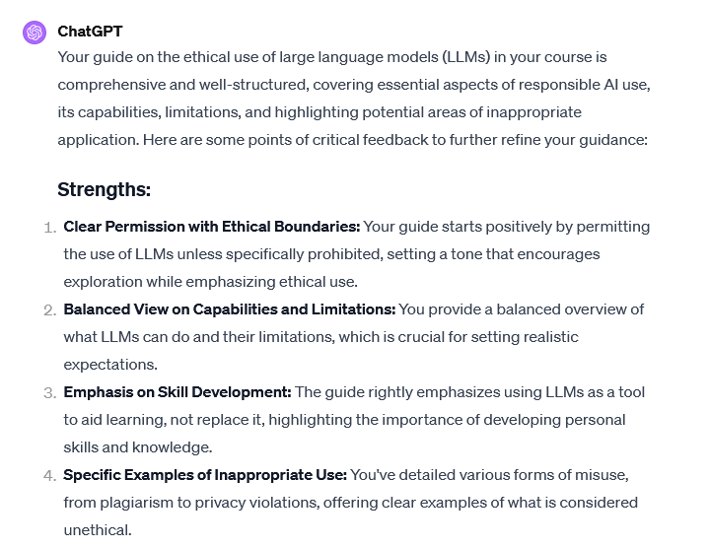
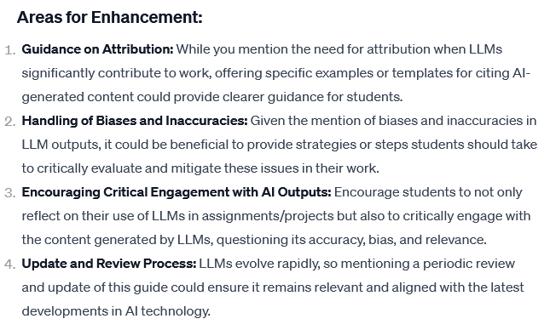

Slide 11
Reflection
I used ChatGPT 4.0 to develop the guidance in an interactive manner. Starting with a high level question pertaining to the purpose of the guide, I systemat systematically delved into more specific aspects of the use of LLMs in an educational setting. In using ChatGPT as a co-pilot, I gained access to a more comprehensive set of issues to raise in relation to the utility of language models, their limitations, and where it is inappropriate to use them. I found the answers to be accurate and sufficiently broad with respect to my questions. With careful editorial review of the generated response, I crafted a guidance that clearly sets out my ethical expectations in this course. I do hope that students are inspired by this and take the opportunity to share their use of AI models throughout the course, except where explicitly contraindicated.

